Slide 1
Quick OS – What does an OS really do?
Perry S. Kivolowitz
Professor, Computer Science

Slide 2
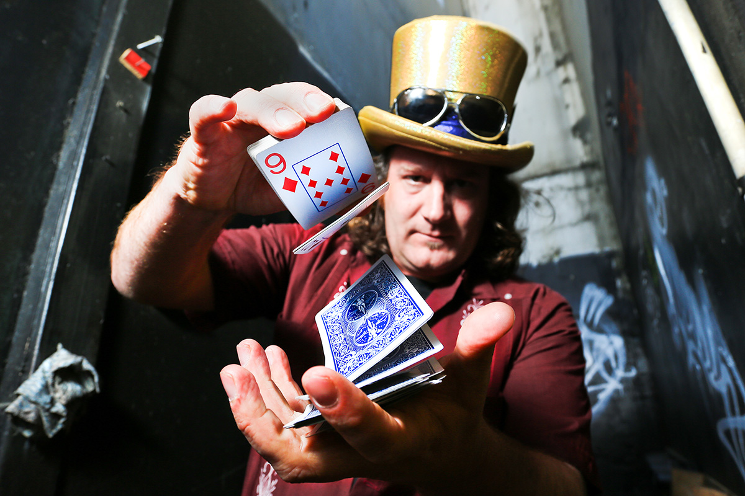
This is what an OS really is

Slide 3
This is what an OS really does
What you think
The truth
You own the CPU
You own memory
You have huge amounts of RAM
You own the disk
Nah
Not really
No, not so much
Not exactly

Slide 4
Virtualization of the CPU
Technique
Purpose
Context switching
Scheduling
You won’t know you’re not alone
Ditto

Slide 5
Virtualization of memory
Technique
Purpose
Virtual address space
Paging
Virtual address translation
You can program like having lots of memory
Programs share memory efficiently
Makes both of the above work

Slide 6
Virtualization of the disk
Technique
Purpose
File systems
File systems
File systems
I/O scheduling
You think disks are organized
You think your files are yours
You think disks are bigger than they are
You get a “fair” turn at the disk

Slide 7
It’s all virtualization
Virtualization is smoke and mirrors
Your OS is the ultimate street magician

